Slide 1

Predicting News Popularity with Supervised Machine Learning
Monday 12/09/2024
Team 2 Section B
Contributors: Achinthya Sreedhar, Neha Shastri, Chaitali Deshmukh, Aryan Sehgal

Slide 2

Problem Statement
Problem: Accurately predicting the success of newly published news articles by forecasting their popularity (clicks/impressions ratio)
Stakeholders: News platforms and publishers
Why: To optimize content selection, promotion strategies, and personalized recommendations, maximizing reader engagement and platform success

Slide 3

Data Source
Microsoft News Dataset (MIND)
Behaviors:
Contains click histories and impression logs of users
Used to analyze user interaction patterns and define the target variable, click percentage
Approx. 5,000,000 records
News:
Contains information of news articles
Used to extract features such as title length and category for predictive modeling
Approx. 55,000 records

Slide 4
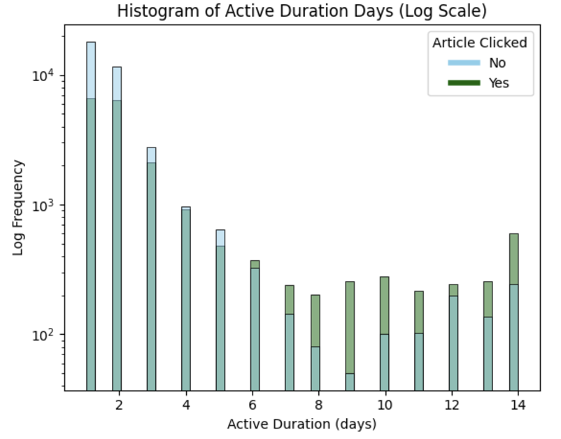
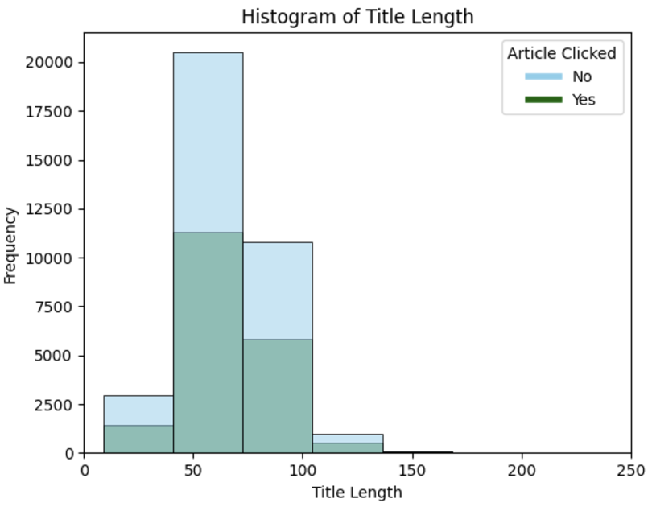
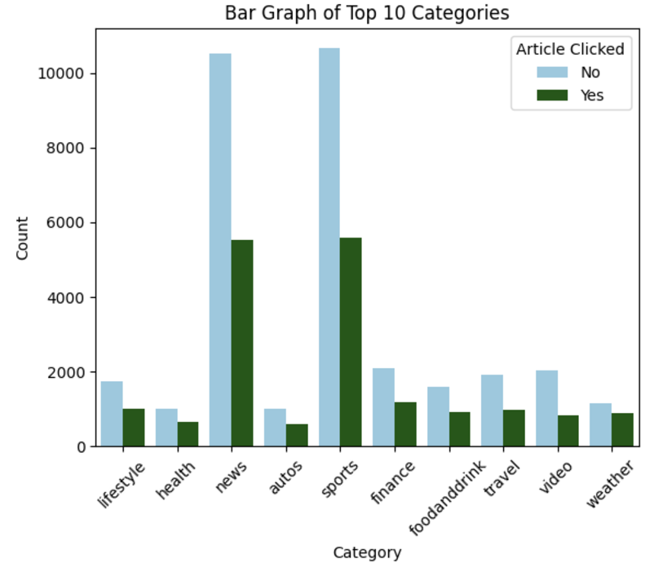
Descriptive Analysis and Insights

Slide 5
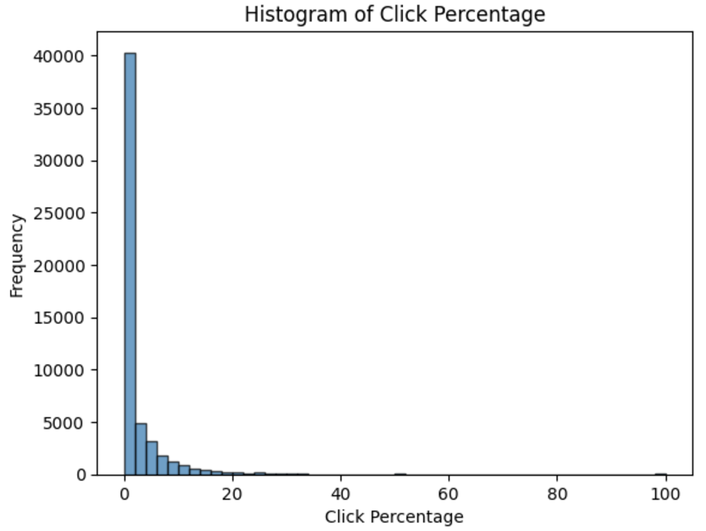
Distribution of Target Variable
Most click percentage values are 0
Indicates the dataset is:
Highly imbalanced
Positively skewed

Slide 6
Machine Learning Methods Applied
Voting Regressor
1
1. SVR
2. CatBoost
Voting Classifier
Input
1. Logistic Regression (Balanced)
2. CatBoost
0
Final Result

Slide 7
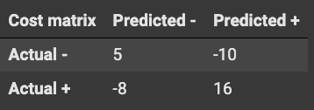
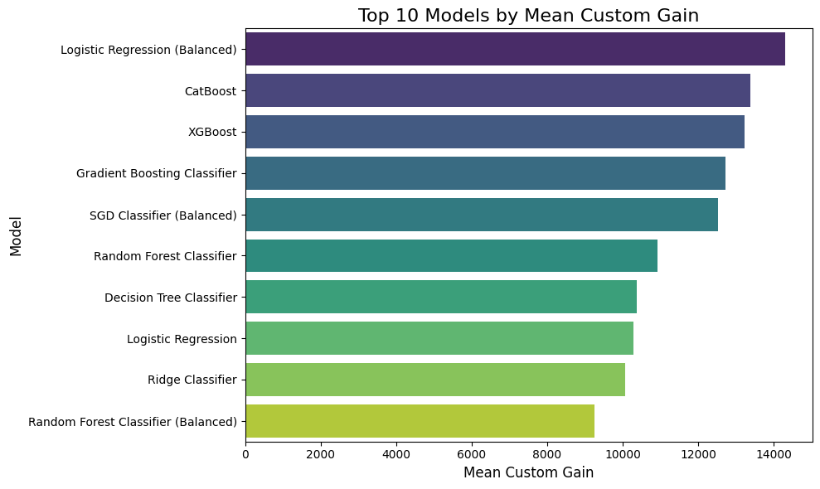
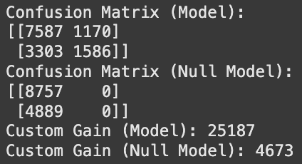
Classification Model
1. Cost Function
3. Value of Top 3 Models After Tuning
2. Top 10 Models During Cross Validation
4. Voting Model Performance Improvement Over Null Model
Notes:
Before we take a look at the top performing models, lets discuss the custom cost function we used. From a publishers perspective, the best outcome is a true positive where the model predicts that an article will be clicked and it actually ends up getting clicks. This is shown by a gain of 16 here. Similarly the worst Possible outcome is a false positive where the model predicts an article to get clicks but ends up not getting any. This is shown in a penalty of -10 here. After evaluating 10 classification models on this custom cost function, the best performing models were balanced logistic regression, catboost and xgboost. Now we used random search hyperparamter tuning to further enhance these models, leading to the best score of 23,700 from Logistic Regression. We then implemented Ensembling with the top two models of LR and catboost via soft voting to improve this score further by 6.2% to 25,200.

Slide 8
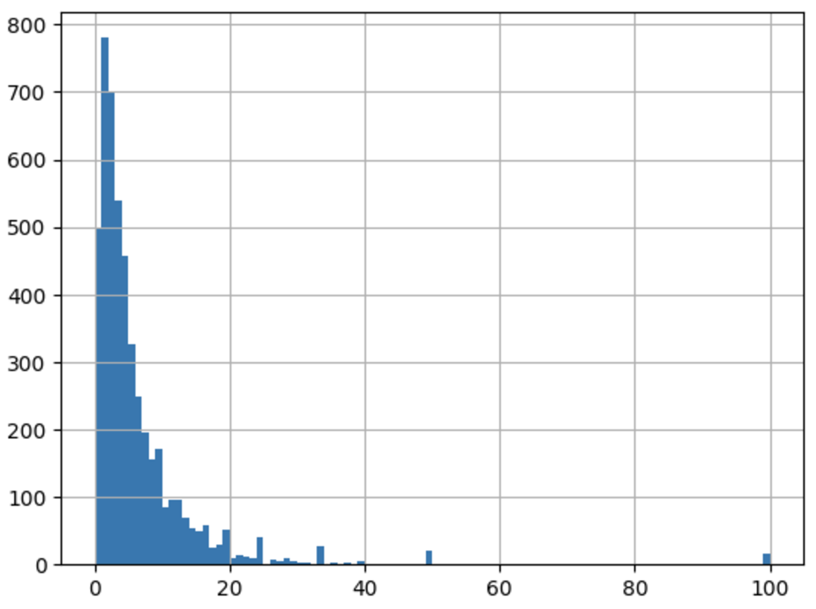
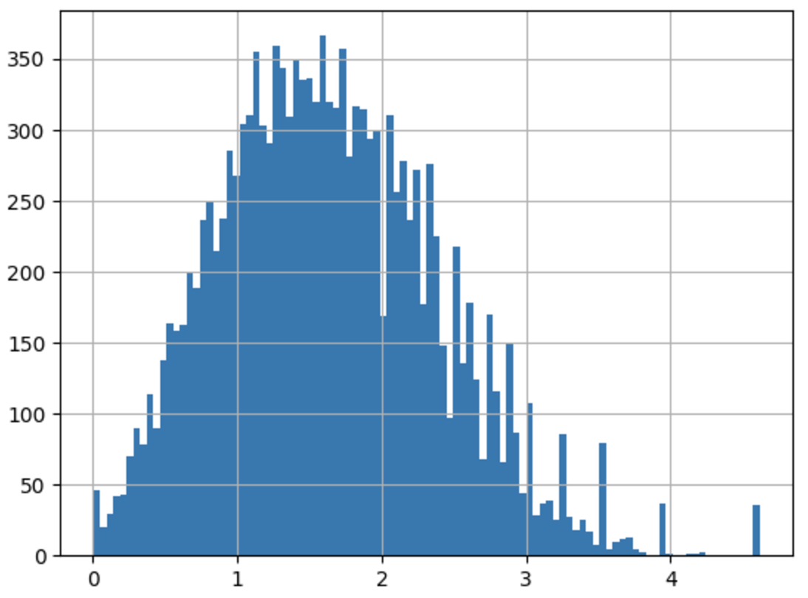
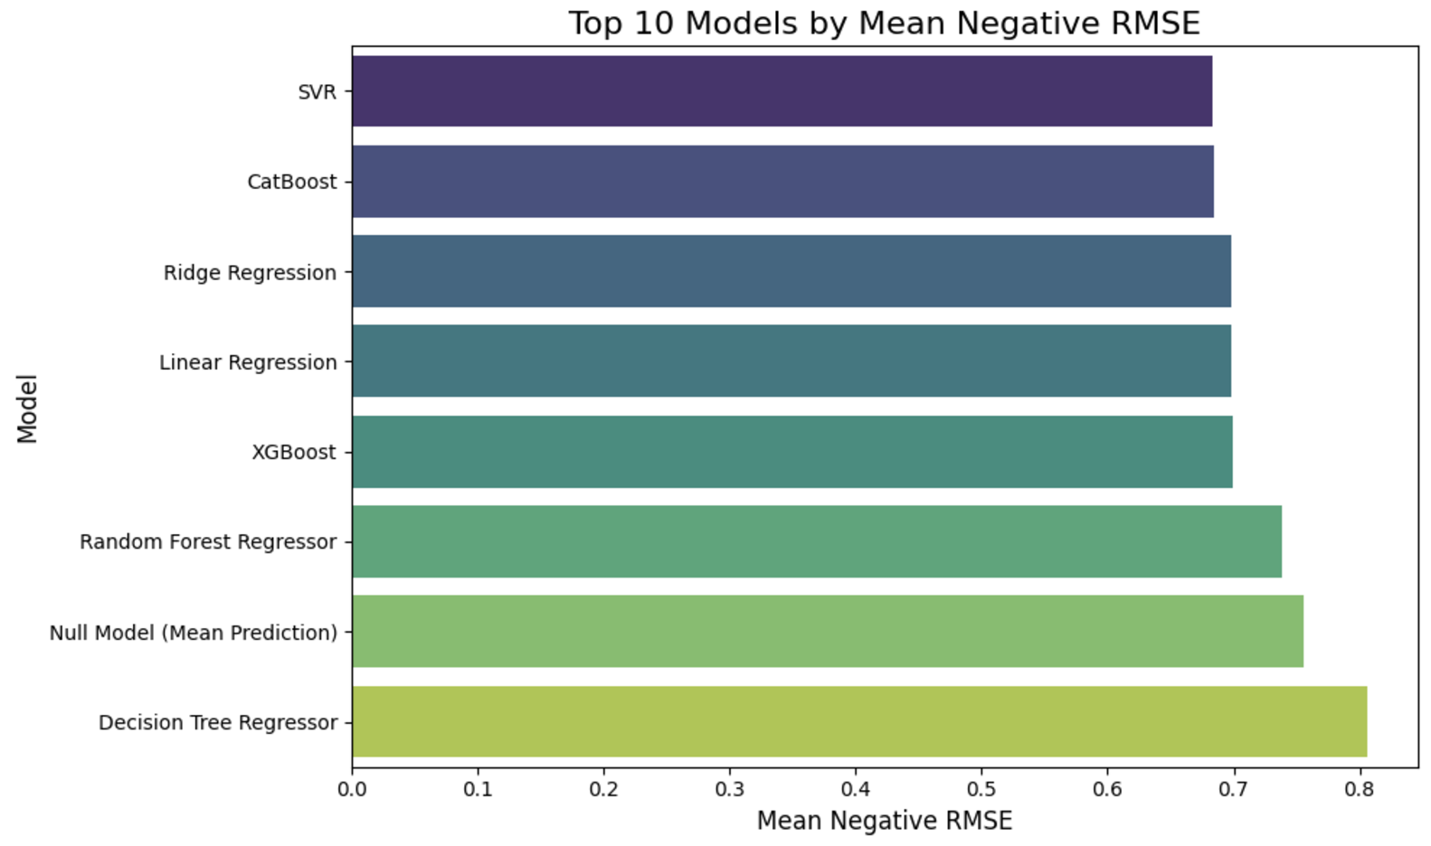
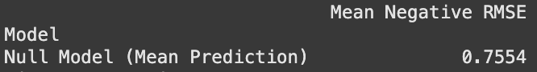
Regression Model
1. Histogram Before and After Applying Log
2. Top 10 Models During Cross Validation
3. RMSE of Top 2 Models After Tuning
4. Voting Model RMSE Over Null Model
Notes:
Moving on to the regression model, as aryan mentioned, the dataset is very skewed. So after considering only the subset of the dataset with articles that have been clicked, we see that the dataset is still skewed to the left, with an average of 10 clicks per article. So we applied a log function to turn the dataset into a normal distribution for our regression models. Comparing over 10 models over the evaluation metric of rmse, the best performers were Catboost Regression and SVR. We applied ensmbling for these two models, using voting, predicting the mean of the 2 model predictions and reduced the rmse score.
The percentage improvement is approximately 10%.

Slide 9
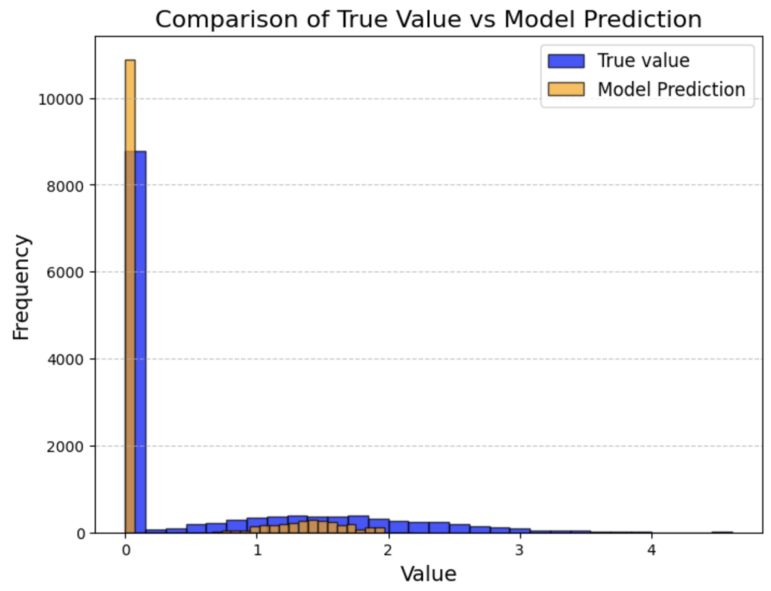
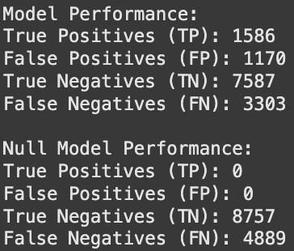
Combined Model

Slide 10

Challenges & Key Takeaways
Extensive Data Preprocessing
Skewed Dataset
Google Trends Integration
Managing Narrowly Distributed Non-Zero Click Percentages
Slow Performance of Certain Models
Stacking Model Challenges
Classifier Voting Limitations

Slide 11

Conclusion & Future Steps
The regression models used were relatively weak learners.
Explore ensemble methods like boosting for better performance.
Integrate search terms with trend velocity to refine predictions.
Expand applications to ads, YouTube videos, and other digital content.

Slide 12
Thank you! Questions?

Slide 13
Link to Final Colab Notebook
Predicting News Popularity With Supervised Machine Learning

